Slide 1
15CSE402
Structure and Interpretation of Computer Programs
Hierarchical Data and Closure Property

Slide 2
Box pointer representation
Provides a way to represent the object in the form of a pointer to a box.
Box for a primitive object contains representation of the object .
  EX: The box for a number simply contains a numeral.
Box for a pair can be viewed as a double box:
  The left part contains pointer to car part.
  The right box contains pointer to cdr part.
2
Pair object representation
(cons 1 2)
Primitive object representation
1

Slide 3
Box pointer representation
Provides a way to represent the object in the form of a
4
1
2
3
4
1
2
3
(cons (cons 1 2) (cons 3 4))
(cons (cons 1 (cons 2 3)) 4)

Slide 4
Closure property
Pairs provides universal building block for constructing higher data structures.
Closure property here plays an important role.
It refers to the ability of creating pairs whose elements themselves are pairs.
An operation of combining objects satisfies closure property if the resultant objects can again be combined using the same operation.
Closure property of cons allows to build hierarchical data.

Slide 5
Hierarchical Data
Sequences
  An ordered collection of data sets.
  Can be represented using a chain of pairs.
  Example: (cons 1 (cons 2 (cons 3 (cons 4 nil))))
  Here, car part represents the 1st object.
  cdr part mark the list of objects in the remaining chain
  cdr of final pair represents end of chain (it is not an object.)
  Scheme provides ‘list’ as a primitive object.
X
1
2
3
4
Chain of pairs (cons 1 (cons 2 (cons 3 (cons 4 nil))))

Slide 6
Hierarchical Data
Sequences
  An ordered collection of data sets.
  Can be represented using a chain of pairs.
  Example: (cons 1 (cons 2 (cons 3 (cons 4 nil))))
  Here, car part represents the 1st object.
  cdr part mark the list of objects in the remaining chain
  cdr of final pair represents end of chain (it is not an object.)
  Scheme provides list as a primitive object.
X
1
2
3
4
Chain of pairs (cons 1 (cons 2 (cons 3 (cons 4 nil))))

Slide 7
List
Provided as a primitive by Scheme.
Equivalent to an ordered chain of cons as seen previously.
Syntax: (list 1, 2, 3, 4)
(list <a>, <b>, <c>, <d>........ <n>)
Equivalent to
(cons <a> (cons <b> (cons <c> (cons <d>.....(cons <n> nil)))))
1
2
3
4
X
(list 1 2 3 4)
Value ‘nil’ can be thought of an empty list

Slide 8
List
Not to get confused between
(list 1 2 3 4)
And
list (1 2 3 4)
Primitive operation “list ” is applied to primitive objects 1, 2 , 3 and 4
‘(1 2 3 4)
Here, ‘1’ will be treated as an operation and 2, 3 & 4 will be treated as arguments.

Slide 9
Cons, Car, Cdr and List
(define one-through-four (list 1 2 3 4))
one-through-four

Slide 10
Cons, Car, Cdr and List
(define one-through-four (list 1 2 3 4))
one-through-four
(1 2 3 4)

Slide 11
Cons, Car, Cdr and List
(define one-through-four (list 1 2 3 4))
One-through-four
(1 2 3 4)
(car one-through-four)

Slide 12
Cons, Car, Cdr and List
(define one-through-four (list 1 2 3 4))
One-through-four
(1 2 3 4)
(car one-through-four)→ 1

Slide 13
Cons, Car, Cdr and List
(define one-through-four (list 1 2 3 4))
One-through-four
(1 2 3 4)
(car one-through-four)→ 1
(cdr one-through-four) → (2 3 4)

Slide 14
Cons, Car, Cdr and List
(define one-through-four (list 1 2 3 4))
One-through-four
(1 2 3 4)
(car one-through-four)→ 1
(cdr one-through-four) → (2 3 4)
(car (cdr one-through-four)) → 2

Slide 15
Cons, Car, Cdr and List
(define one-through-four (list 1 2 3 4))
One-through-four
(1 2 3 4)
(car one-through-four)→ 1
(cdr one-through-four) → (2 3 4)
(car (cdr one-through-four)) → 2
(cons 10 one-through-four) → (10 1 2 3 4)

Slide 16



(cons 10 one-through-four)
10
x
1
2
3
4
()

Slide 17






(cons 10 one-through-four)
10
1
2
3
4
()
10
1
2
3
4
()

Slide 18







(1 2 3 4)
1
2
3
4
()
(10 1 2 3 4)
10
1
2
3
4
()

Slide 19
Operations on Lists
Accessing elements of the list:
Successively CDRing down the list except for the first element.
Start the numbering of the elements from zero.
Steps:
For n = 0, return the first item of the list.
Otherwise, return the (n - 1)st items of the of the list with a decremented n.

Slide 20
List Operations: list-ref
(define (list-ref items n)
??
)

Slide 21
List Operations: list-ref
(list-ref '(1 4 9 16 25) n)
if n = 0 ??
otherwise ??
First item in the list

Slide 22
List Operations: list-ref
(list-ref '(1 4 9 16 25) n)
if n = 0 first item of the list be
returned
Otherwise ??

Slide 23
List Operations: list-ref
(define (list-ref items n) (if (= n 0)
(car items)
Otherwise ??
)

Slide 24
List Operations: list-ref
(list-ref '(1 4 9 16 25) n)
if n = 0
(car items)
Otherwise
take (n-1)items of list and decrement n by 1

Slide 25
List Operations: list-ref
(list-ref '(1 4 9 16 25) n)
if n = 0
(car items)
Otherwise
(list-ref (cdr items) (- n 1))
)
This list refers to the term ‘items’

Slide 26
Operations on Lists
Accessing elements of the list:
Procedure:
(define (list-ref items n)
(if (= n 0)
(car items)
(list-ref (cdr items) (- n 1))))

Slide 27
List Operations: list-ref
(define squares (list 1 4 9 16 25)) squares
'(1 4 9 16 25)
(list-ref squares 3)
16
4th element returned.
Numbering starts from 0.

Slide 28
List operations: Length of List
(define odds (list 1 3 5 7)) odds
'(1 3 5 7)
(length odds)
4
Approach:
1. Check for empty list?
2. Access elements sequentially.
3. Decrement the index ‘n’ and increment ‘counter’.

Slide 29
List Operations: length
(define (length items)
??
)
‘(1 2 3 4)
Or
(list 1 2 3 4)

Slide 30
List Operations: length
(length items)
length = 1 + length of cdr of the
Item list
(Decrementing index)
Allows linear acess to elements.
Drops one element at a time in each iteration
Incrementing counter)
Counting elements sequentially.

Slide 31
List Operations: length
Checking empty? list condition
Null?
(length items)
??
length = 1 + length of cdr of the
Item list

Slide 32
List Operations: length
(length items)
(null? items)
0
Length= 1 + length of cdr of the
Item list

Slide 33
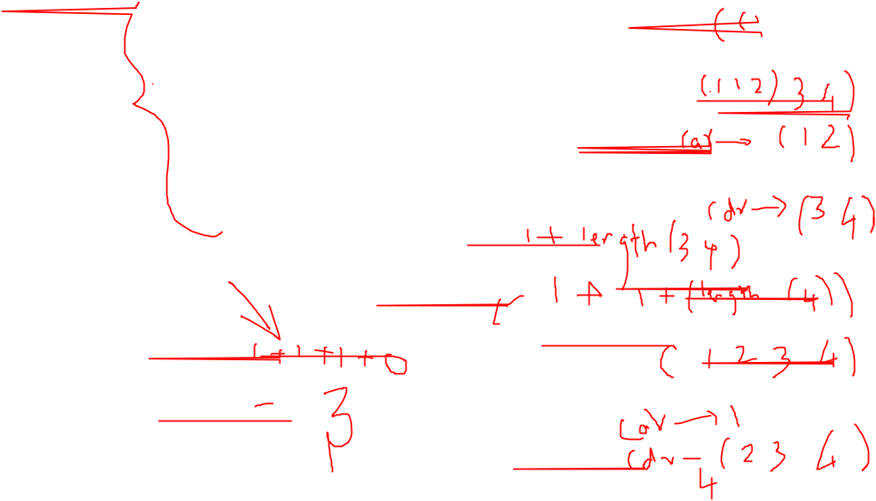
List Operations: length
(define (length items)
( (if(null? items)
0
(+ 1 (length (cdr items)))
    )
    )

Slide 34
List Operations: length
(define (length items)
(define (length-iter a count)
(if (null? a)
count
(length-iter (cdr a) (+ 1 count))
)
)
(length-iter items)
) 0))

Slide 35
List Operations: length
(define (length items)
(define (length-iter a count)
(if (null? a)
count
(length-iter (cdr a) (+ 1 count))
)
)
(length-iter items 0)
) 0))

Slide 36
List Operations: append
squares
'(1 4 9 16 25)
odds
'(1 3 5 7)
(append odds squares)
'(1 3 5 7 1 4 9 16 25)

Slide 37
List Operations: append
squares
odds
(1 3 5 7)
(1 4 9 16 25)
(append odds squares)
(1 3 5 7 1 4 9 16 25)
(cons 7 squares) = (7 1 4 9 16 25)

Slide 38
List Operations: append
squares
odds
(1 3 5 7)
(1 4 9 16 25)
(append odds squares)
(1 3 5 7 1 4 9 16 25)
(cons 7 squares) → (7 1 4 9 16 25)
(cons 5 (cons 7 squares)→ (5 7 1 4 9 16 25)

Slide 39
List Operations: append
squares
odds
(1 3 5 7)
(1 4 9 16 25)
(append odds squares)
(1 3 5 7 1 4 9 16 25)
(cons 7 squares) → (7 1 4 9 16 25)
(cons 5 (cons 7 squares)→ (5 7 1 4 9 16 25)
(cons 3 (cons 5 (cons 7 squares) →
(3 5 7 1 4 9 16 25)

Slide 40
List Operations: append
squares
odds
(1 3 5 7)
(1 4 9 16 25)
(append odds squares)
(1 3 5 7 1 4 9 16 25)
(cons 7 squares) → (7 1 4 9 16 25)
(cons 5 (cons 7 squares)→ (5 7 1 4 9 16 25)
(cons 3 (cons 5 (cons 7 squares) →
(3 5 7 1 4 9 16 25)
(cons | 1 | (cons | 3 | (cons | 5 | (cons | 7 squares) | →
 |  |  |  |  |  |  | (1 3 5 7 1 | 4 9 | 16 25)

Slide 41
List Operations: append
If list1 is the empty list, then the result is just list2.
Otherwise, append the cdr of list1 and list2, and cons the car of list1 onto the result

Slide 42
List Operations: append
(define (append list1 list2)
??
)

Slide 43
List Operations: append
(define (append list1 list2)
??
(cons (car list1)
(append (cdr list1) list2))
)

Slide 44
List Operations: append
(define (append list1 list2)
(if (null? list1)
list2
(cons (car list1)
(append (cdr list1) list2)))

Slide 45
List Operations: append
(define (append list1 list2) (if (null? List1)
list2
(cons (car list1)
(append (cdr list1) list2))
)
)

Slide 46
List Operations: scale-list
Scales the items in the list with a user-defined factor.
The result is also a list.
Example:
(scale-list (list 1 2 3 4) 5)
'(5 10 15 20)
scale-list multiplies the items in the list by 5

Slide 47
List Operations: scale-list
(scale-list (list 1 2 3 4) 5)
(5 10 15 20)
(1 2 3 4) ≡
(cons 1 (cons 2 (cons 3 (cons 4 nil))))

Slide 48
List Operations: scale-list
(scale-list (list 1 2 3 4) 5)
(5 10 15 20)
Step 1: Extracting each element for scaling.
Apply successive car to sub-lists.
Step 2: Extract successive sub-lists
Apply successive cdr
Step 3: Reconstruct the list
Step 4: Apply desired operation on car items extracted using Step-1

Slide 49
List Operations: scale-list
(scale-list (list 1 2 3 4) 5)
(5 10 15 20)
Step 1: Extracting each element for scaling.
Apply successive car to sub-lists.
(define | (scale-list | items | factor)
 | (car items)
 | ???? |  | )

Slide 50
List Operations: scale-list
(scale-list (list 1 2 3 4) 5)
(5 10 15 20)
Step 2: Extract successive sub-lists
Apply successive cdr
(define | (scale-list | items | factor)
( | (car items)
 | (scale-list ) | (cdr | items) factor | ))

Slide 51
List Operations: scale-list
(scale-list (list 1 2 3 4) 5)
(5 10 15 20)
Reconstruct the list from resultant items successively.
(1 2 3 4) ≡
(cons 1 (cons 2 (cons 3 (cons 4 nil))))
(define | (scale-list | items | factor)
(cons | (car items)
) | (scale-list | (cdr | items) factor | ))
????Deciding the stopping criteria

Slide 52
List Operations: scale-list
(scale-list (list 1 2 3 4) 5)
(5 10 15 20)
(define (scale-list items factor)
(if (null? items)
nil
(cons (car items)
(scale-list (cdr items) factor))
))
‘nil’ is provided by Scheme
Represents an empty list

Slide 53
List Operations: scale-list
(scale-list (list 1 2 3 4) 5)
(5 10 15 20)
Apply desired operation for getting resultant data
(define (scale-list items factor)
(if (null? items) nil
(cons (* (car items) factor)
(scale-list (cdr items) factor))
))

Slide 54
List Operations: scale-list
(scale-list (list 1 2 3 4) 5)
(1 2 3 4)
Simply replace ‘*’ operator by abs
(define (scale-list items factor)
(if (null? items) nil
(cons (* (car items) factor)
(scale-list (cdr items) factor))
))
Can be replaced by a procedure performing multiplication.
Ex Replace highlighted text by:
(mul-item (car items) factor)

Slide 55
List Operations: scale-list
(scale-list (list 1 2 3 4) 5)
(1 2 3 4)
Simply replace ‘*’ operator by
Mul-item procedure
(define (scale-list items factor)
(if (null? items) nil
(cons (mul-item (car items) factor)
(scale-list (cdr items) factor))
))
Where
(define (mul-item a factor)
(* a factor)

Slide 56
List Operations: abs-list
(scale-list (list 1 -2 -3 4) 5)
(1 2 3 4)
Simply replace the procedure applied to car
(define (abs-list items factor)
(if (null? items) nil
(cons (abs-item (car items) factor)
(abs-list (cdr items factor)))
))
Where
(define (abs-item a )
(abs a)

Slide 57
List Operations: square-list
(square-list (list 1 2 3 4))
(1 4 9 16)
Simply replace the procedure applied to car
(define (square-list items factor)
(if (null? items) nil
(cons (square-item (car items) factor)
(square-list (cdr items factor)))
))
Where
(define square-item a )
(* a a)

Slide 58
List Operations: MAP
Different operations can be performed on list items by simply making a single modification to the procedure applied to CAR.
Leaves an open-space for using Higher order procedures
Referred to MAPPING OF LIST.

Slide 59
List Operations: MAP
Scale-list / abs-list / square-list / ...
Optional
(define (________ items _____)
(if (null? items)
nil
(cons (__________ (car items) _____)
(______ (cdr items) _____))
))
Optional
Optional
Scale-list / abs-list / square-list / ...
Mul-item / abs-item / square-item

Slide 60
List Operations: MAP
Generalize the element accessing
(define ( map items proc)
(if (null? items)
nil
(cons (proc (car items) )
(map(cdr items) proc))
))
Proc === Scale-list / abs-list / square-list / ...

Slide 61
List Operations: MAP
Generalize the element accessing
(define ( map items proc)
(if (null? items)
nil
(cons (proc (car items) )
(map(cdr items) proc))
))
(define (scale-list items factor)
(define (mul-item a)
(* a factor))
(map mul-item items)
)
(define (scale-list items factor)
(map (lambda (x) (* x factor))
items))

Slide 62
List Operations: MAP
Generalize the element accessing
(define ( map items proc)
(if (null? items)
nil
(cons (proc (car items) )
(map(cdr items) proc))
))
(define (abs-list items factor)
(define abs-item a)
(abs a))
(map items abs-item)
)
(define (abs-list items factor)
(map items abs))

Slide 63
List Operations: MAP
Generalize the element accessing
(define ( map items proc)
(if (null? items)
nil
(cons (proc (car items) )
(map(cdr items) proc))
))
(define (square-list items factor)
(define square-item a)
(* a a))
(map square-item items)
)
(define (square-list items factor)
(map (lambda (x) (* x x)) items))

Slide 64
List Operations: map
(map (10 | (list 2 3 4) | -10 | 2 | -3 | 4) | abs)
(map (list 1 2 3 4)
(lambda (x) (* x x))
)

Slide 65
(cons (list 1 2) (list 3 4) )

Slide 66
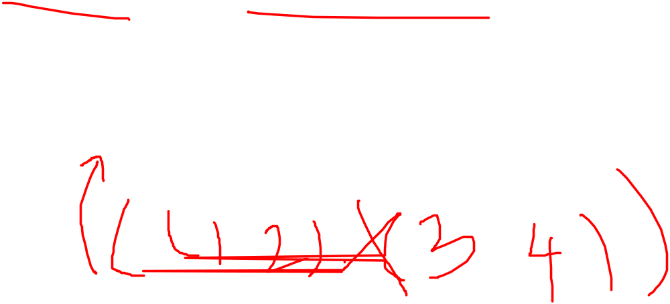
(cons (list 1 2) (list 3 4) )
((1 2) 3 4)

Slide 67
(cons (list 1 2) (list 3 4) )

Slide 68


(cons (list 1 2) (list 3 4) )
1
2
()

Slide 69


(cons (list 1 2) (list 3 4) )
3
4
()
1
2
()

Slide 70


(cons (list 1 2) (list 3 4) )
3
4
()
1
2
()

Slide 71



(cons (list 1 2) (list 3 4) )
3
4
()
1
2
()

Slide 72
(cons (list 1 2) (list 3 4) )
3
4
()
1
2
()
(X 3 4)

Slide 73
(cons (list 1 2) (list 3 4) )
3
4
()
1
2
()
((1 2) 3 4)

Slide 74
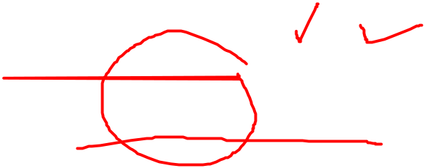



((1 2) 3 4)
X
4
3

Slide 75



((1 2) 3 4)
(1 2)
4
3
1
2

Slide 76

(define |  | x | (cons | (list | 1 | 2)
 |  |  |  | (list | 3 | 4)))
((1 | 2) | 3 | 4)
(length x)

Slide 77
(define | x | (cons |  |  | (list | 1 | 2)
 |  |  |  |  | (list | 3 | 4)))
((1 2) | 3 | 4)
(length | x) |  | → | 3

Slide 78
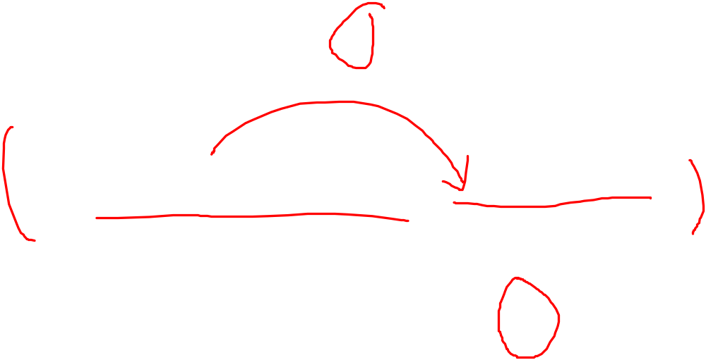
(define | x | (cons |  |  | (list | 1 | 2)
((1 2) | 3 | 4) |  |  | (list | 3 | 4)))
(length (list x | x) x) |  | → | 3

Slide 79

(length x) → 3
(list x x) → ( ( (1 2) 3 4) ⁽ ⁽¹ ²⁾ ³ ⁴ ⁾ ⁾
(define | x | (cons | (list | 1 | 2)
 |  |  | (list | 3 | 4)))
((1 2) | 3 | 4)

Slide 80
(length x) → 3
(list x x) → ( ( (1 2) 3 4) ⁽ ⁽¹ ²⁾ ³ ⁴ ⁾ ⁾
(length (list x x))
(define | x | (cons | (list | 1 | 2)
 |  |  | (list | 3 | 4)))
((1 2) | 3 | 4)

Slide 81
(length x) → 3
(list x x) → ( ( (1 2) 3 4) ⁽ ⁽¹ ²⁾ ³ ⁴ ⁾ ⁾
(length (list x x)) → 2
(define | x | (cons | (list | 1 | 2)
 |  |  | (list | 3 | 4)))
((1 2) | 3 | 4)

Slide 82
(length x) → 3
(list x x) → ( ( (1 2) 3 4) ⁽ ⁽¹ ²⁾ ³ ⁴ ⁾ ⁾
(length (list x x)) → 2
(count-leaves x)→ 4
(define | x | (cons | (list | 1 | 2)
 |  |  | (list | 3 | 4)))
((1 2) | 3 | 4)

Slide 83
((1 2) 3 4)
(1 2)
4
3
1
2
(count-leaves x)→ 4

Slide 84
(define | x | (cons | (list | 1 | 2)
 |  |  | (list | 3 | 4)))
((1 2) | 3 | 4)
(length x) → 3
(list x x) → (((1 2) 3 4)⁽⁽¹ ²⁾ ³ ⁴⁾⁾
(length (list x x))→ 2
(count-leaves x)→ 4
(count-leaves (list x x))

Slide 85
(define | x | (cons | (list | 1 | 2)
 |  |  | (list | 3 | 4)))
((1 2) | 3 | 4)
(length x) → 3
(list x x) → (((1 2) 3 4)⁽⁽¹ ²⁾ ³ ⁴⁾⁾
(length (list x x))→ 2
(count-leaves x)→ 4
(count-leaves (list x x))→ 8

Slide 86
(((1 2) 3 4)((1 2) 3 4))

Slide 87


(((1 2) 3 4)((1 2) 3 4))

Slide 88
(((1 2) 3 4)((1 2) 3 4))
((1 2) 3 4)

Slide 89
(((1 2) 3 4)((1 2) 3 4))
((1 2) 3 4) ((1 2) 3 4)

Slide 90



(((1 2) 3 4)((1 2) 3 4))
((1 2) 3 4) ((1 2) 3 4)

Slide 91
(((1 2) 3 4)((1 2) 3 4))
((1 2) 3 4) ((1 2) 3 4)
3

Slide 92
(((1 2) 3 4)((1 2) 3 4))
((1 2) 3 4) ((1 2) 3 4)
3
4

Slide 93
(((1 2) 3 4)((1 2) 3 4))
((1 2) 3 4) ((1 2) 3 4)
(1 2)
3
4

Slide 94


(((1 2) 3 4)((1 2) 3 4))
((1 2) 3 4) ((1 2) 3 4)
(1 2)
3
4

Slide 95
(((1 2) 3 4)((1 2) 3 4))
((1 2) 3 4) ((1 2) 3 4)
(1 2)
3
4
1

Slide 96
(((1 2) 3 4)((1 2) 3 4))
((1 2) 3 4) ((1 2) 3 4)
(1 2)
3
4
1 2

Slide 97
(((1 2) 3 4)((1 2) 3 4))
((1 2) 3 4) ((1 2) 3 4)
(1 2)
3
4
1 2

Slide 98





(((1 2) 3 4)((1 2) 3 4))
((1 2) 3 4) ((1 2) 3 4)
(1 2)
(1 2)
3
4
3
4
1 2
1 2

Slide 99
(((1 2) 3 4)((1 2) 3 4))
((1 2) 3 4) ((1 2) 3 4)
(1 2)
(1 2)
3
4
3
4
1 2
1 2
(count-leaves (list x x))→ 8

Slide 100
length
(length '(1 3 5 7))
length = 1 + length of cdr of the list
//Dropping car() one by one
Check length of empty list is 0
at the end.

Slide 101
List Operations: length
(define (length items)
( (if(null? items)
0
(+ 1 (length (cdr items)))
    )
    )
NOTE: Car() is always a number / primitive object in case of a sequence.
-> No need to analyze data returned by Car()

Slide 102
count-leaves
(count-leaves '((1 2) 3 4) )
NOTE:
Here, data returned by Car() can be a list / pair.
-> Need for analyzing data returned by Car()

Slide 103
count-leaves
(count-leaves '((1 2) 3 4) )
count-leaves of empty list = 0.

Slide 104

count-leaves
(count-leaves '((1 2) 3 4) )
1. count-leaves of empty list = 0 2. count-leaves of tree =
count-leaves of car + count-leaves of cdr

Slide 105
count-leaves
(count-leaves '((1 2) 3 4) )
1. count-leaves of empty list = 0 2. count-leaves of tree =
count-leaves of car + count-leaves of cdr
3. count-leaves of a leaf = 1

Slide 106
count-leaves
(count-leaves '((1 2) 3 4) )
=

Slide 107
count-leaves
(count-leaves '((1 2) 3 4) )
Car() of the list
= | (count-leaves | (1 | 2)) | +
 | (count-leaves | (3 | 4))
Cdr() of the list

Slide 108
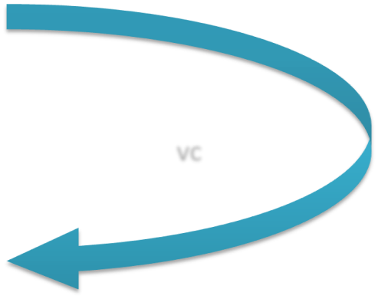

count-leaves
(count-leaves '((1 2) 3 4) )
= | (count-leaves | (1 | 2)) | +
 | (count-leaves | (3 | 4))
vc
vc
= ((count-leaves 1) + (count-leaves (2)))
+
((count-leaves 3) +
(count-leaves (4))

Slide 109


count-leaves
= ((count-leaves 1) + (count-leaves (2)))
+
((count-leaves 3) +
(count-leaves (4))
vc
vc
= | 1 | + + | (count-leaves (count-leaves | 2) ())
1 + |  |  | + (count-leaves | 4)
+ |  |  | (count-leaves | ())

Slide 110
count-leaves
= | 1 | + + | (count-leaves (count-leaves | 2) ())
1 + |  |  | + (count-leaves | 4)
+ |  |  | (count-leaves | ())
= | 1 | + + | 1 0
1 + |  |  | + 1
+ |  |  | 0

Slide 111
count-leaves
= | 1 1 | + + | 1 + 0 + 1 + 0
= | 4

Slide 112
count-leaves
(count-leaves '((1 2) 3 4) )
1. count-leaves of empty list = 0 2. count-leaves of tree =
count-leaves of car + count-leaves of cdr
3. count-leaves of a leaf = 1

Slide 113
count-leaves
(count-leaves '((1 2) 3 4) )
1. count-leaves of empty list = 0 2. count-leaves of tree =
count-leaves of car +
count-leaves of cdr
3. count-leaves of a leaf = 1
(how to check a leaf????)
(a leaf is a non-pair!!)

Slide 114
count-leaves
(count-leaves '((1 2) 3 4) )
1. count-leaves of empty list = 0 2. count-leaves of tree =
count-leaves of car +
count-leaves of cdr
3. count-leaves of a leaf = 1
(how to check a leaf????)
(a leaf is a non-pair!!)
Scheme provides pair?

Slide 115
count-leaves
(define (count-leaves x)
??
)

Slide 116
count-leaves
1. List is empty??
(define (count-leaves x) (cond ( (null? x) 0)
(
)
)
( else
)

Slide 117
count-leaves
1. List is empty??
(define (count-leaves x) (cond ((null? x) 0)
((not (pair? x) 1)
( else )
)
2. List is leaf ??

Slide 118
count-leaves
1. List is empty??
(define (count-leaves x)
(cond ((null? x) 0)
((not (pair? x) 1)
(else (+ (count-leaves (car x))
(count-leaves (cdr x))))
))
2. List is leaf ??
2. List is pair or list ??

Slide 119
List Operations: scale-list
(define (scale-list items factor)
(if (null? items)
nil
(cons (* (car items) factor)
(scale-list (cdr items) factor))
))

Slide 120
(scale-tree
(list 1 (list 2 (list 3 4) 5) (list 6 7))
10)

Slide 121
(scale-tree
(list 1 (list 2 (list 3 4) 5) (list 6 7))
10)
(10 (20 (30 40) 50) (60 70))

Slide 122
count-leaves of empty list is 0
count-leaves of tree =
count-leaves of car + count-leaves of cdr
count-leaves of a leaf is 1

Slide 123
scale-tree of empty list is 0
scale-tree of tree =
scale-tree of car + scale-tree of cdr
scale-tree of a leaf is
(* leaf factor)

Slide 124
scale-tree
(define (scale-tree tree factor)
??
)

Slide 125
scale-tree of empty list is 0
scale-tree of tree =
scale-tree of car + scale-tree of cdr
scale-tree of a leaf is
(* leaf factor)

Slide 126
scale-tree
(define (scale-tree tree factor) (cond (null? tree) nil)
(
)
)
(else
)

Slide 127
scale-tree of empty list is 0
scale-tree of tree =
scale-tree of car + scale-tree of cdr
scale-tree of a leaf is
(* leaf factor)

Slide 128
scale-tree
(define (scale-tree tree factor)
(cond (null? tree)
nil)
((not (pair? tree))
(* tree factor))
(else )
)

Slide 129
scale-tree of empty list is 0
scale-tree of tree =
scale-tree of car + scale-tree of cdr
scale-tree of a leaf is
(* leaf factor)

Slide 130

scale-tree
(define (scale-tree tree factor)
(cond (null? tree)
nil)
((not (pair? tree))
(* tree factor))
(else
(cons
))))
(scale-tree | (car | tree) | factor)
(scale-tree | (cdr | tree) | factor)

Slide 131

List Operations: scale-list
(define (scale-list items factor) (if (null? items)
nil
(cons (* (car items) factor)
(scale-list (cdr items) factor))
))

Slide 132
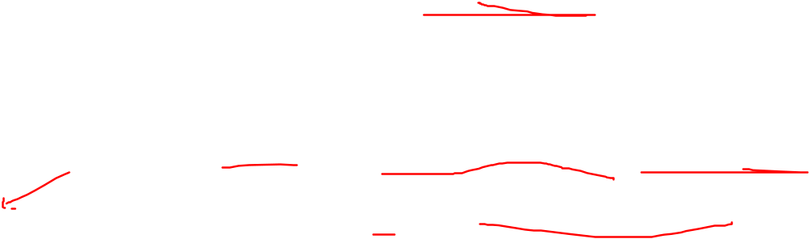
List Operations: map
(define (map proc items) (if (null? items)
nil
(cons (proc (car items) ) (map proc (cdr items)))
))

Slide 133
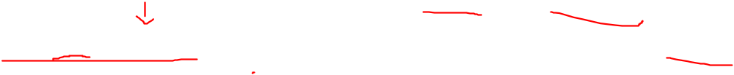
scale-list in terms of map
(define (scale-list items factor)
(map (lambda (x) (* x factor)) items)

Slide 134
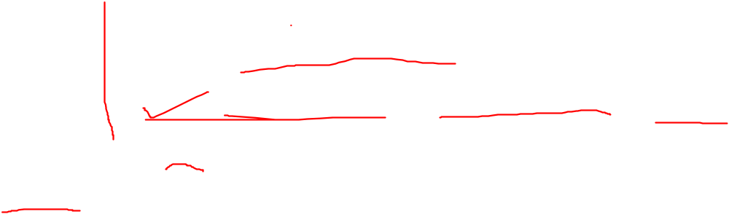
scale-tree in terms of map
(define (scale-tree tree factor)
(map (lambda (sub-tree)
(if (pair? sub-tree)
(scale-tree sub-tree factor)
(* sub-tree factor)))
tree))

Slide 135
CSE221
Structure and Interpretation of Computer Programs
Conventional Interfaces

Slide 136
sum-odd-squares (ref. scale-tree)
(define (scale-tree tree factor) (cond (null? tree) nil)
((not (pair? tree)) (* tree factor)) (else (cons
))))
(scale-tree | (car | tree) | factor)
(scale-tree | (cdr | tree) | factor)

Slide 137
sum-odd-squares (ref. scale-tree)
(define (scale-tree tree factor) (cond (null? tree) nil)
((not (pair? tree)) (* tree factor)) (else (cons
))))
(scale-tree | (car | tree) | factor)
(scale-tree | (cdr | tree) | factor)

Slide 138
sum-odd-squares
(define | (sum-odd-squares tree)
(cond | (null? tree) )
 | ((not (pair? tree)) )
 | (else (
 | (sum-odd-squares | (car | tree) | )
 | (sum-odd-squares | (cdr | tree) | )
))))

Slide 139
sum-odd-squares
(define | (sum-odd-squares tree)
(cond | (null? tree) 0)
 | ((not (pair? tree)) )
 | (else (
 | (sum-odd-squares | (car | tree) | )
 | (sum-odd-squares | (cdr | tree) | )
))))

Slide 140
sum-odd-squares
(define | (sum-odd-squares tree)
(cond | (null? tree) 0)
 | ((not (pair? tree))
 | (if (odd? tree) (square | tree) | 0))
 | (else (
 | (sum-odd-squares (car | tree) | )
 | (sum-odd-squares (cdr | tree) | )
))))

Slide 141
sum-odd-squares
(define (sum-odd-squares tree) (cond (null? tree) 0)
((not (pair? tree))
(if (odd? tree) (square tree) 0)) (else (+
(sum-odd-squares (car tree) )
(sum-odd-squares (cdr tree) )
))))

Slide 142
???
(define (??? n) (define (next k)
(if (> k n)
nil
(let ((f (fib k))) (if (even? f)
(cons f (next (+ k 1)))
(next (+ k 1))))))
(next 0))

Slide 143
even-fibs
(define (even-fibs n) (define (next k)
(if (> k n)
nil
(let ((f (fib k))) (if (even? f)
(cons f (next (+ k 1)))
(next (+ k 1))))))
(next 0))

Slide 144
Abstract Description of even-fibs
Enumerate the integers from 0 to n
●
Compute Fibonacci number of each integer
●
Filter them selecting even ones
●
Accumulate result using cons, starting with empty list
●

Slide 145
Enumerate the integers from 0 to n
(0 1 2 3 4 5 6 7 8 9 10)
Compute Fibonacci number of each
integer
(0 1 1 2 3 5 8 13 21 34 55)
●
Filter them selecting even ones (0 2 8 34)
●
Accumulate them (0 2 8 34)
●

Slide 146
sum-odd-squares
(define | (sum-odd-squares tree)
(cond | (null? tree) 0)
 | ((not (pair? tree))
 | (if (odd? tree) (square | tree) | 0))
 | (else (
 | (sum-odd-squares (car | tree) | )
 | (sum-odd-squares (cdr | tree) | )
))))

Slide 147
Abstract Description of sum-odd-squares
Enumerate the leaves of a tree
●
Filter them selecting odd ones
●
Square each of selected odd ones
●
Accumulate result using +, starting with 0
●

Slide 148
Enumerate the leaves of tree (list 1 (list 2 (list 3 4)) 5)
(1 2 3 4 5)
Filter them selecting odd ones (1 3 5)
●
Square each of selected ones (1 9 25)
●
Accumulate them 35
●

Slide 149






Enumerate tree leaves
Filter: odd?
map square
Accumulate
+,0
Enumerate
integers
map
fib
Filter Even?
Accumulate cons,()

Slide 150
enumerate-interval and
enumerate-tree
(enumerate-interval 1 7)
(1 2 3 4 5 6 7)

Slide 151
enumerate-interval
(define (enumerate-interval low high) (if (> low high)
nil
(cons low
(enumerate-interval (+ low 1) high)
)))

Slide 152
enumerate-interval and
enumerate-tree
(enumerate-interval 1 7)
(1 2 3 4 5 6 7)
(enumerate-tree (list 1 (list 2 3) 4))
(1 2 3 4)

Slide 153
enumerate-tree
(define (enumerate-tree tree) (cond ((null? tree) nil)
((not (pair? tree)) (list tree) (else (append
))
(enumerate-tree | (car | tree))
(enumerate-tree | (cdr | tree))))

Slide 154
filter
(filter odd? (list 1 2 3 4 5))
(1 3 5)

Slide 155
filter
(define (filter predicate sequence) (cond ((null? sequence) nil)
((predicate (car sequence)) (cons (car sequence)
(filter predicate (cdr sequence))) (else (filter predicate (cdr sequence)))))

Slide 156
accumulate
(accumulate 15 | + | 0 | (list | 1 | 2 | 3 | 4 | 5))
(accumulate 120 | * | 1 | (list | 1 | 2 | 3 | 4 | 5))
(accumulate cons nil (list 1 2 3 4 5))
(1 2 3 4 5)

Slide 157
accumulate
(define (accumulate op initial sequence) (if (null? sequence)
initial
(op (car sequence)
(accumulate op initial (cdr sequence)))
))

Slide 158
sum-odd-squares
(define (sum-odd-squares tree) (cond (null? tree) 0)
((not (pair? tree))
(if (odd? tree) (square tree) 0)) (else (+
(sum-odd-squares (car tree) )
(sum-odd-squares (cdr tree) )
))))

Slide 159
sum-odd-squares
(define (sum-odd-squares tree)
??
)

Slide 160
sum-odd-squares
(define (sum-odd-squares tree)
(enumerate-tree tree)
)

Slide 161
sum-odd-squares
(define (sum-odd-squares tree)
(filter odd?
(enumerate-tree tree)
))

Slide 162
sum-odd-squares
(define (sum-odd-squares tree)
(map square
(filter odd?
(enumerate-tree tree)
)))

Slide 163
sum-odd-squares
(define (sum-odd-squares tree) (accumulate +
0
(map square
(filter odd?
(enumerate-tree tree)
))))

Slide 164
even-fibs
(define (even-fibs n) (accumulate cons
nil
(filter even?
(map fib
(enumerate-interval 0 n)
))))

Slide 165
list-fib-squares
(define (list-fib-squares n) (accumulate cons
nil
(map square
(map fib
(enumerate-interval 0 n)
))))

Slide 166
prod-sqr-odd-elements
(define (prod-sqr-odd-elements sequence) (accumulate *
1
(map square
(filter odd? sequence)
)))

Slide 167
sal-of-hghst-paid-pgmr
(define (sal-of-hghst-paid-pgmr records) (accumulate max
0
(map salary
(filter programmer?
records)
)))

